Slide 1
ENDER’S GAME – Chapters 1-8
Study Guide PowerPoint
Chapters 1 and 2
Vocabulary
Class Discussion Chapter 1.1
Class Discussion Chapter 1.2
Class Discussion Chapter 2.1
Class Discussion Chapter 2.2
Study Guide Chapters 1-2
Chapters 3 and 4
Vocabulary
Class Discussion Chapter 3.1
Class Discussion Chapter 3.2
Class Discussion Chapter 4.1
Class Discussion Chapter 4.2
Study Guide Chapters 3-4
Chapters 1-4 Review
Pod Talk/Share 1-4: Themes
Chapter 1-4 Graphic Organizers
Prediction Chart
Character Attribute Web
Story Maps
Chapters 1-8 Review
Pod Talk/Share 1-8: Themes/Settings
Chapter 5-6 Graphic Organizers
Prediction Chart
Character Attribute Web 5-6
Character Attribute Web 7-8
Story Maps 5-6
Story Maps 7-8
Writing Prompt 3
Aligned Standards
Chapters 5 and 6
Vocabulary
Media Com/Con 5-6.1
Media Com/Con 5-6.2a
Media Com/Con 5-6.2b
Media Com/Con 5-6.2c
Media Com/Con 5-6.3
Study Guide Chapters 1-2
Chapters 7 and 8
Vocabulary
Media Com/Con 7.1-5
Media Com/Con 8.1
Media Com/Con 8.2
Study Guide Chapter 7
Study Guide Chapter 8

Slide 2
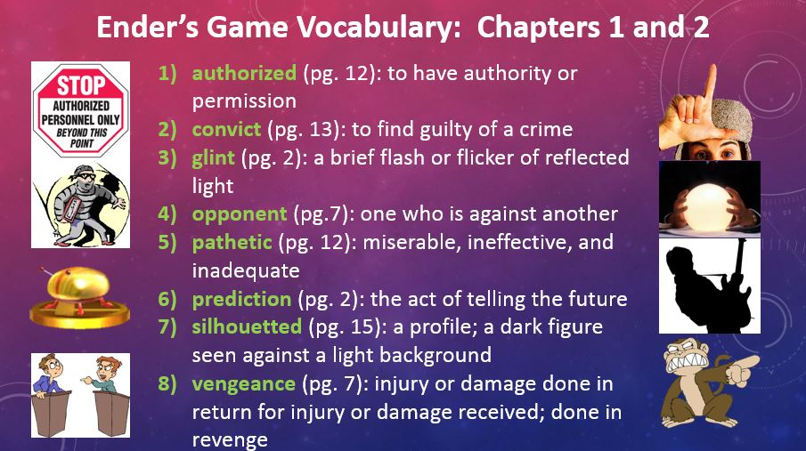

Slide 3
Chapter 1 Discussion Responses
Pod 1 and 2.)
Monitor/government – is an important part to the storyline, also because it is a different point of view than the rest of the story.
Who is talking at the beginning of each chapter? Why is the type in different print?
Pod 3 & 4.)
Adults believe that telling a lie will protect you from a painful truth. Ender has learned, because of this, it is often easier to understand when an adult is lying.
Sometimes adults lie to protect our feelings or keep us from being afraid.
Ender thinks, “Sometimes lies were more dependable than the truth.” Why does he think this?

Slide 4
Chapter 1 Discussion Responses
Pod 5.)
He has the feeling of something he has lost or cannot find. He was in a state of confusion.
He was confused. Both Peter and Stilson are bullies, they’re dangerous.
He recognizes both as enemies and in his state of confusion cannot remember which enemy Stilson is.
Ender returns to class and confuses Stilson with Peter. What does this reveal about Ender’s present state?
Pod 6 & 7.)
He is smart, vengeful because he is scaring off the other children.
He wanted to win all the fights in one, not continue to fight the same fight every day.
He wanted to make sure he won every future fight against the gang, not just the one for that day against Stilson.
Although he knows it’s forbidden to strike someone who’s already on the ground, Ender kicks Stilson. Why?
What does this say about Ender’s character?

Slide 5
Chapter 2 Discussion Responses
Pod 1 and 2.)
The gov. wants to see how he will react when he is in danger to be sure he will succeed in Battle School. The whole situation was set up as a test to see what his motives for violence are.
To know what he is thinking when he fights. They know Peter is violent, so they needed to be sure Ender was acting in self-defense and not for the sake of being violent.
That was the final test, and they wanted to see if he would buckle under pressure. They want to see how much like Peter he is, because Peter was not accepted due to his violent nature.
Government observers want to see how Ender will react to his brother, not what his angry brother will do to him. Why?
Pod 3 & 4.)
No, because Peter was kicked out of the program for being too violent. Also, Peter was acting violently (sitting on him, pushing his groin) while threatening Ender.
No, because Peter is violent and dangerous. He has behaved this way through childhood.
No, because Peter was physically hurting him when he was saying it, pressing on his chest with his knee.
Does Ender believe Peter when he says the threat to kill him and Valentine was a joke?

Slide 6
Chapter 2 Discussion Responses
Pod 5, 6, & 7.)
Ender tries to be tough but also still has a soft side. He is ashamed of what he did during his fight with Stilson.
He does not like being violent. He is very sensitive.
He only cries when he is in pain or if he has done something he is not proud of.
Twice, Ender cries; after the fight with Stilson and after his brother apologizes to him.
What does Ender crying at these times say about his character?

Slide 7
Chapter 1-2 Study Guide Questions
What is Ender’s first name? Andrew
Where is Ender’s monitor at the beginning of the story? In the back of his neck
Who is Peter? Ender’s brother
What does Ender doodle on his desk? A contour map of mountainous islands
What letters march across Ender’s desk? THIRD
How does Stilson know Ender’s monitor has been removed? Because of the bandaid on his neck
Where does Ender kick Stilson? In the breastbone, the ribs, the groin, and the face
How old were Valentine and Peter when they lost their monitors? Valentine was 3, and Peter was 5
What is a bugger? An alien
What does Ender put on for the war game? A bugger mask
What does Peter threaten to do to Ender? Kill him

Slide 8
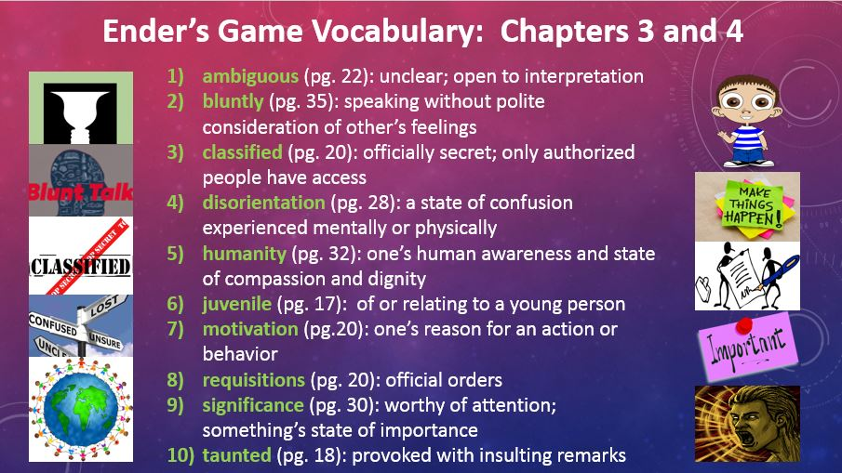

Slide 9
Chapter 3 Discussion Responses
Pod 1 and 2.)
1st) To see if he was fighting for fun or for defense. He fought the way he did because if he had not, he would have continued to get bullied by Stilson and gang.
2nd) He was not wanting to fight, he was just defending himself. IF wants to be sure he will be a defender of humanity. Graff wanted to be sure he was fighting for the right reasons and not just to be violent.
7th) Shows he has wisdom and thinks before he acts. They want to make sure he is not going to just fight to be fighting, but acts out of necessity or self-defense.
Graff says it isn’t the fight that earned Ender an invitation to enter Battle School, it was why he fought as he did. Why is this important?
Pod 3 & 4.)
1st) As long as you try, you will make it.
2nd) If you try hard and are determined to succeed, you will make it. It is similar to college, if you work hard and are dedicated, you will be successful.
7th) If at first you don’t succeed, try try again. You need to be determined to be successful. If you try hard you will be able to get through the first year.
Ender is told that all who want to make it through the first year make it. What does this mean?

Slide 10
Chapter 3 Discussion Responses
Pod 5.)
Parents are embarrassed because they have a third, but they do love him and would never admit they want him to go. His brother is anxious for him to be gone, and Valentine wants him to stay.
Parents – No because they love him and are afraid of him/Yes, because he is a source of tension in the home because he is a Third. Peter – No, because he is jealous. Val – No, because she loves him.
Mom and dad love him and want him to stay, but the fact that he is a third causes problems for the family, and though they would not admit it, life would be easier if he were gone. Peter wants Ender to leave, because he is jealous of him, but he is also upset he is the one chosen to go to Battle School. Valentine does not want him to go because she loves Ender.
Ender’s family dynamics are very complicated. Do his parents want him to stay home or not?
Do his brother and sister want him to go?
Pod 6 & 7.)
To make sure Ender was volunteering to go to Battle School because it is dangerous and he would be risking his life.
He wanted to make sure he was ready and that him going to BS was voluntary.
To make sure Ender understand the decision he is making and that he will not change his mind.
Why does Graff ask Ender three times if he wants to go to Battle School?

Slide 11
Chapter 4 Discussion Responses
Pod 1 and 2)
To show the other boys Ender is better than all of them. He wants to show them one day he might be their leader and that he has the skills and capabilities of doing so.
So if he is bullied, he could see if Ender would defend himself.
Graff believes in order for Ender to be successful as a leader, he must feel like he has to solve his problems on his own and cannot count on anyone coming to “save” him.
Why does Graff single Ender out and make the other boys dislike him?
Pod 3 & 4)
Ender doesn’t like hurting people but he will do so in self-defense.
It shows he does not like to hurt people. That he is a good fighter but does not want to fight. He will use violence in self defense even though he does not like being violent.
He does not like hurting people, but he understand he must protect himself and sometimes violence can be the only way to stop an enemy.
Ender reacts to the blows on the head by anticipating his attacker’s movement and flipping him forward.
After the boy is hurt, Ender feels terrible. What does this say about his character?

Slide 12
Chapter 4 Discussion Responses
Pod 5, 6 & 7)
So Ender isn’t so heartbroken when Graff trains him (breaks him down to build him up). Tries to isolate Ender to make him stronger by realizing he (Ender) is the only person he can count on (no friends).
He wants Ender to be tough and self-reliant in Battle School – not to depend on others (friends) to “save” him in difficult situations.
He wants Ender to feel alone and isolated, because he needs Ender to be serious in order to lead. Amend: He wants Ender to feel alone, and if he were to tell him he was his friend, Ender would count on being “saved” from conflicts. Graff needs him to prove he can figure out how to resolve issues on his own.
Why doesn’t Graff admit to Ender what he tells Anderson: “The kid’s wrong. I am his friend”?

Slide 13
Chapter 3-4 Study Guide Questions
Who do the observers feel is the weak link? Why? Valentine; because Ender loves her
How does the family know someone is at the door? The table beeps
Who is at the door? Colonel Hyrum Graff of the International Fleet
What does Ender do after he explains the fight to Colonel Graff? He cries
What is Graff’s job? Director of primary training at Battle School in the Belt
Who comes from noncompliant families? Ender’s mom and dad – both came from families with more than 2 children
Who was the hero of the last bugger war? Mazer Rackham
How long has it been since the last war? 80 years
Why can’t Ender laugh when he’s with the other boys going to the launch? He’s afraid
Why is Ender hungry before the launch? He couldn’t eat 20 hours before the launch.
Who does Graff say is the only boy with brains on the launch? Ender
What happens to the boy Ender flips? His left arm is broken.
Why did Ender think Graff was his friend? He didn’t lie to him.

Slide 14
POD TALK/SHARE Chapter 1-4
What are some possible themes of Ender’s Game we have already encountered?
Major Themes:
Good vs. Evil
Children vs. Adults
Minor Themes:
Don’t judge a book by its cover.

Slide 15
Prediction Question Chapter 1-4
1-2: Do you think Peter will actually try to kill Ender?
3-4: How will Ender make the other boys respect him?
Chapter/Pages | CHARACTERS | CONFLICT | PREDICTION | WHY? | CORRECT?
Chpt 1 & 2 Pg 31 – Pg 45 | Andrew Wiggin Stilson Peter Valentine | Ender v Stilson (CvC) Ender v Peter (CvC) Ender examining what his actions against Stilson mean (CvSe) | I predict Peter will/will not try to kill Ender. | I predict this because… … reason 1 … reason 2 … etc
Chpt 3 & 4 Pg 46 - 68 | Mom/Dad Graff | Ender v Decision to go to Battle School (CvSe/CvSo) | I predict Ender will make the other boys respect him by … | I predict this because… (refer to all GO’s, notes, and the text to support your reason)

Slide 16
Character Attribute Web: Chapters 1-4
f
What Ender thinks:
What Ender says:
What Ender does:
Has to win the fight with Stilson for all time, not just this once, or will fight it every day.
Continuing to harm a helpless enemy is some-thing animals do.
Thinks Graff is his friend because he is nice and honest.
“…just remember what I do to people who try to hurt me. It wouldn’t be this bad … it would be worse.”
“Take away my monitor and I am just like Peter.” (p38)
“Knocking him down won the first fight. I wanted to win all the next ones, too. So they’d leave me alone.
Repeatedly kicked Stilson while he was down.
Chooses to go with Graff to Battle School in hopes of saving humanity, even though Graff explains how difficult it will be.
Easily reorients himself to the idea of null gravity.
Grabs boy’s arm on launch ship who is hitting him. Flips him out and over the seat and breaks his arm.
Environment (School/Home/Battle School):
What others do to Ender:
Bullied at school by Stilson and his gang.
Bullied at home by brother Peter.
Sister Valentine loves him and visa versa.
Stilson and his friends ganged up on Ender after school because he no longer had his monitor.
Peter makes Ender be the bugger in a game – threatens to kill him – apologizes when he thinks Ender is asleep.
Andrew Wiggin
“Ender”
Mom and dad love him, but his presence reminds them they are afraid to be noncompliant.
Authority interaction or inaction and how it affects Ender’s decisions:
Other conflicts that affect Ender:
Monitor off, Ender believed no one would interfere in the fight against Stilson.
Futuristic society where families are only allowed to have 2 children, Ender is a THIRD, requisitioned by the government in hopes to create a military leader. Thirds and their families are generally looked down upon. This is one reason there is conflict between Ender and both Stilson and Peter.
Ender is monitored to see how he reacts to Peter if he believes no one will interfere.
Graff informs Ender the final step in his testing was to see what would happen when the monitor came off.
Graff isolates Ender from the other launchies in hopes to make him a more effective soldier/leader.

Slide 17
STORY MAP: Chpt 1-2
STORY MAP: Chpt 3-4
Ender gets monitor removed.
IF Officer Colonel Hyrum Graff visits the Wiggin home to find out what Ender’s motives were for the way he fought Stilson. He then tells the family Ender has been accepted to Battle School after all.
Stilson and gang corner Ender after school and start a fight. Ender thoroughly beats Stilson by continuing to kick him while he is down (chest, ribs, groin, face).
Graff and Ender have a private conversation where Graff explains the difficulties he will face at Battle School as well as the reasons his family is conflicted about him going (mom and dad come from noncompliant families and Ender being a third is a source of tension in their home.)
Ender feels bad for being put in the position where he was forced to defend himself. Realizes without the monitor he acts just like “Peter”
Ender agrees to go to Battle School with the hopes of being able to help save humanity/Earth.
Peter and Ender play a game of bugger vs. astronauts. Peter hurts Ender (toe in groin/kneels on chest) and threatens to kill Ender and Valentine “one day”
During the launch, Graff isolates Ender from the other launchies by telling them Ender is the best of the best, and the only one who has any brains. One boy hits Ender repeatedly on the head and he defends himself by flipping the boy over the seat and breaking his arm.
Peter apologizes for threatening to kill them while he thinks Ender is sleeping.
Ender is upset Graff set him apart from the other boys because he though he was his friend. Graff explains his job is not to be his friend, but to produce the best soldiers in the world.

Slide 18
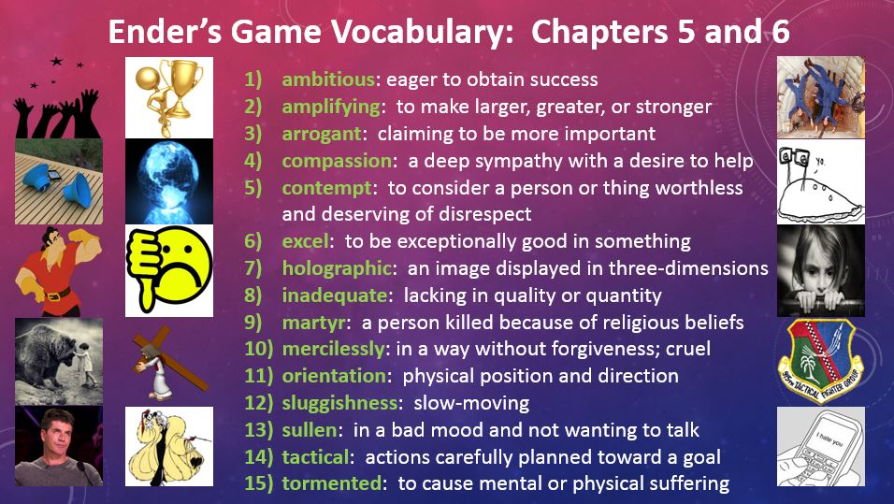

Slide 19
Chapter 5-6 Media Compare and Contrast
The Game Room: 01:09:30 – 1:14:06 (Book, pg. 77-81)
How did going back to read about the game room help you better understand who Ender is as a tactician (soldier/leader)?
Categorize and record information discussed in your pod and in class in your character attribute web.
Identify at least two adjectives that describe Ender to add to your Sociogram activity sheet.
(T) Plans ahead using what he has observed and learned from the situation (GR while watching other boys “I could beat them this way. I could beat them that way.” (pg 79) Sociogram Adjectives (ENDER): Observant, smart, inventive, tactical, not gullible
(D) Caught on quickly by watching older boys. Learned controls and maneuvers by their hand movements. (T) The book offers internal dialog to Ender’s thought patterns as he was observing in the game room.
Sociogram Adjectives (ENDER): Tough, brave, smart, agile, trustworthy, tactical, skillful, inventive
(D) He studied the game and came up with a strategy before challenging one of the older boys. (S) Goaded the older boys by saying “If you can’t do it twice, you can’t do it at all.” (pg 80) (T) He thinks he is skilled enough to learn the game quickly and defeat the older boys. Sociogram Adjectives (ENDER): cunning, smart, witty, strategic, independent, strong, tactical, inventive

Slide 20
Chapter 5-6 Media Compare and Contrast
The Battleroom: 01:21:16 – 01:34:38 (Book, pg. 88-95)
Compare how the book explains the relationships between Ender and the other soldiers versus the movie. Use a Vinn Diagram to organize your data. What relationships are introduced in the book/movie? How did the book/movie make the reader/viewer understand the importance of these relationships? Consider Ender’s relationships with Alai and Bernard as well as his launch group in general.
Book: Differences
Book/Movie: Similarities
Movie: Differences
Ender broke Bernard's arm on launch ship, causing conflict between the characters as well as Ender and the launch group. Ender is bullied by several of the launch group and Bernard. In the BR, Ender interacts with and builds a relationship with Alai to create a bridge between Ender and the other soldiers.
Both introduces reader/viewer to the BR.
Bean is the soldier in the BR rather than Alai. There is no conflict or conflict resolution shown between Ender and the other soldiers in the BR.

Slide 21
Chapter 5-6 Media Compare and Contrast
The Battleroom: 01:21:16 – 01:34:38 (Book, pg. 88-95)
Compare how the book explains the relationships between Ender and the other soldiers versus the movie. Use a Vinn Diagram to organize your data. What relationships are introduced in the book/movie? How did the book/movie make the reader/viewer understand the importance of these relationships? Consider Ender’s relationships with Alai and Bernard as well as his launch group in general.
Book: Differences
Book/Movie: Similarities
Movie: Differences
Bernard was the boy whose arm Ender broke on launch and becomes a source of conflict – bullying in the bunks. Alai and Ender interacted in the BR examining equipment and null gravity. Ender uses this new friendship to mend conflict with Bernard and other soldiers. Alai and Ender teamed up with Bernard and Shen to take on the rest of the launch group.
Both show some conflicts among the lauchies, but not in the BR. Both book and movie contain scenes from the BR.
Shows Bean and Ender interacting in the BR examining equipment and null gravity rather than Alai. Does not show the mock battle between Ender and the other boys against the rest of the soldiers in the BR.

Slide 22
Chapter 5-6 Media Compare and Contrast
The Battleroom: 01:21:16 – 01:34:38 (Book, pg. 88-95)
Compare how the book explains the relationships between Ender and the other soldiers versus the movie. Use a Vinn Diagram to organize your data. What relationships are introduced in the book/movie? How did the book/movie make the reader/viewer understand the importance of these relationships? Consider Ender’s relationships with Alai and Bernard as well as his launch group in general.
Book: Differences
Book/Movie: Similarities
Movie: Differences
Ender interacts with Alai in the BR, learning equipment and maneuvers. The conflict with Bernard and the other launchies is explained (Ender broke his arm on the launch ship). Ender and Alai team up with Bernard and Shen and take on the rest of their launch group who is still flailing around uncontrollably.
Ender learned how to maneuver and fire the laser pistol in null gravity (BR scene was in both). The pistol freezes the suits where they hit. The soldiers at the Battle School have to examine the last battles videos to better understand their enemy (the buggers).
Ender does not do as much to gain respect of the soldiers, it does not fully explain the conflict with Bernard and other launchies. Bean is the soldier Ender teams up with to examine the equipment rather than Alai.

Slide 23
Chapter 5-6 Media Compare and Contrast
The Giant’s Drink/Fairyland: 01:36:11 – 01:40:45 (Book, pg. 96-98)
Compare the difference between how Ender reacted to his decision to kill the giant in the mind game in the book versus his reaction from the movie. What does the way Ender defeated the giant in the game say about how he will treat an enemy in actual battle?
(B) He compared himself to a murderer, even though it was just a game. He said “Peter would be so proud of me”. (M) He told Alai the (IF/authority) want them to respond with violence, but seemed more disturbed by the idea they wanted these violent acts rather than the fact that he had reacted violently.
(B) Ender said he was a murderer and Peter would be proud of him. Shows him struggling with the frustration of continually dying by killing the giant. (M) He was okay with it because he knew it was what the IF wanted from them. Graff and Anderson were watching him while he played the game. Anderson yelled at Graff because she needed to observe Ender somehow, and the mind game was the best way to do so.
(M) Ender reacted fairly calmly and accepted it was something expected of him. (B) He called himself a murderer. He was upset that he was forced to either continue being defeated or choose violence to make it passed the giant. He said, “Peter would be proud of me”.

Slide 24
Chapter 5-6 Study Guide Questions
What bunk does Ender get? The lower bunk by the door
What is in the compartment with the space suit? A pistol
What is the boys’ color code? Red, yellow, yellow
What does it mean to “ice out”? To be sent back to Earth
Which games does Ender study in the older boys’ area? The holographic ones with hovering objects
What is the first message Ender sends on the desk? “Cover your butt. Bernard is watching.”
Who is the first of the Launchies to befriend Ender? Shen
Who does Ender approach in the battleroom? Alai
What happens when Ender is shot in the foot? The leg of his suit is frozen
Who are the four boys who take on the rest of the class? Ender, Alai, Shen, and Bernard
Who is chosen as launch leader? Alai
How does Ender win against the Giant? He kicks over the death drinks and attacks the Giant’s eye, killing him.

Slide 25


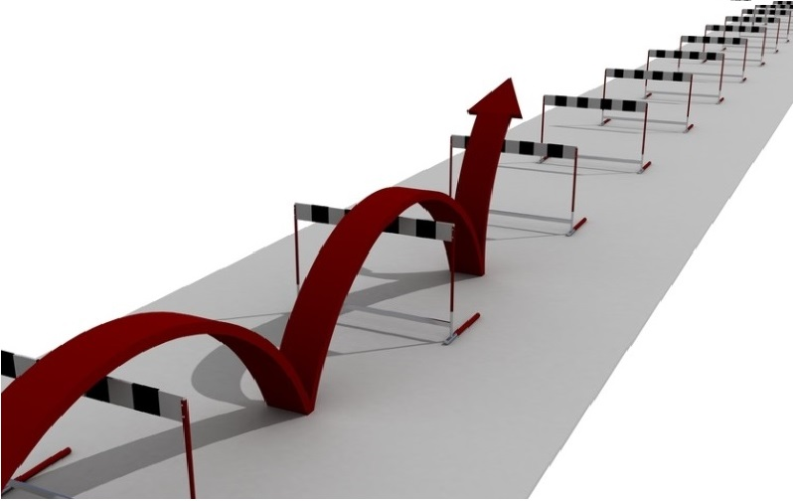



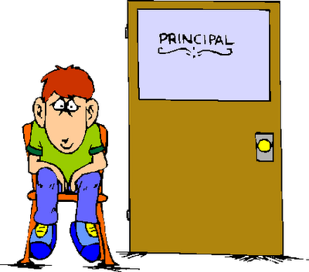



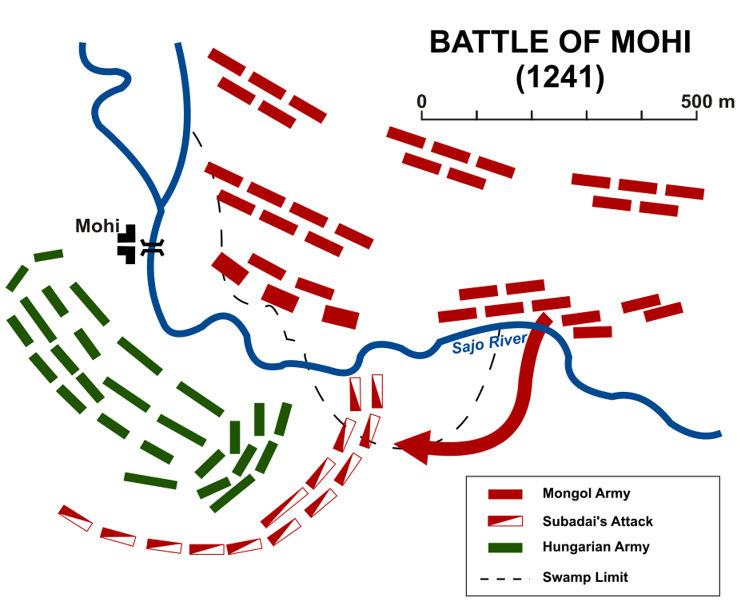
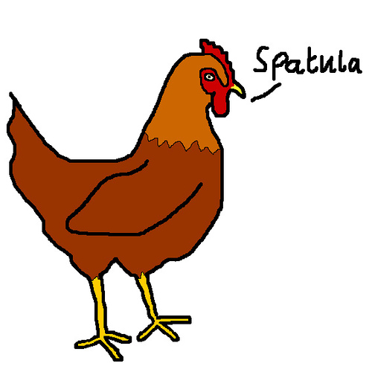



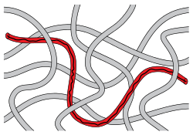

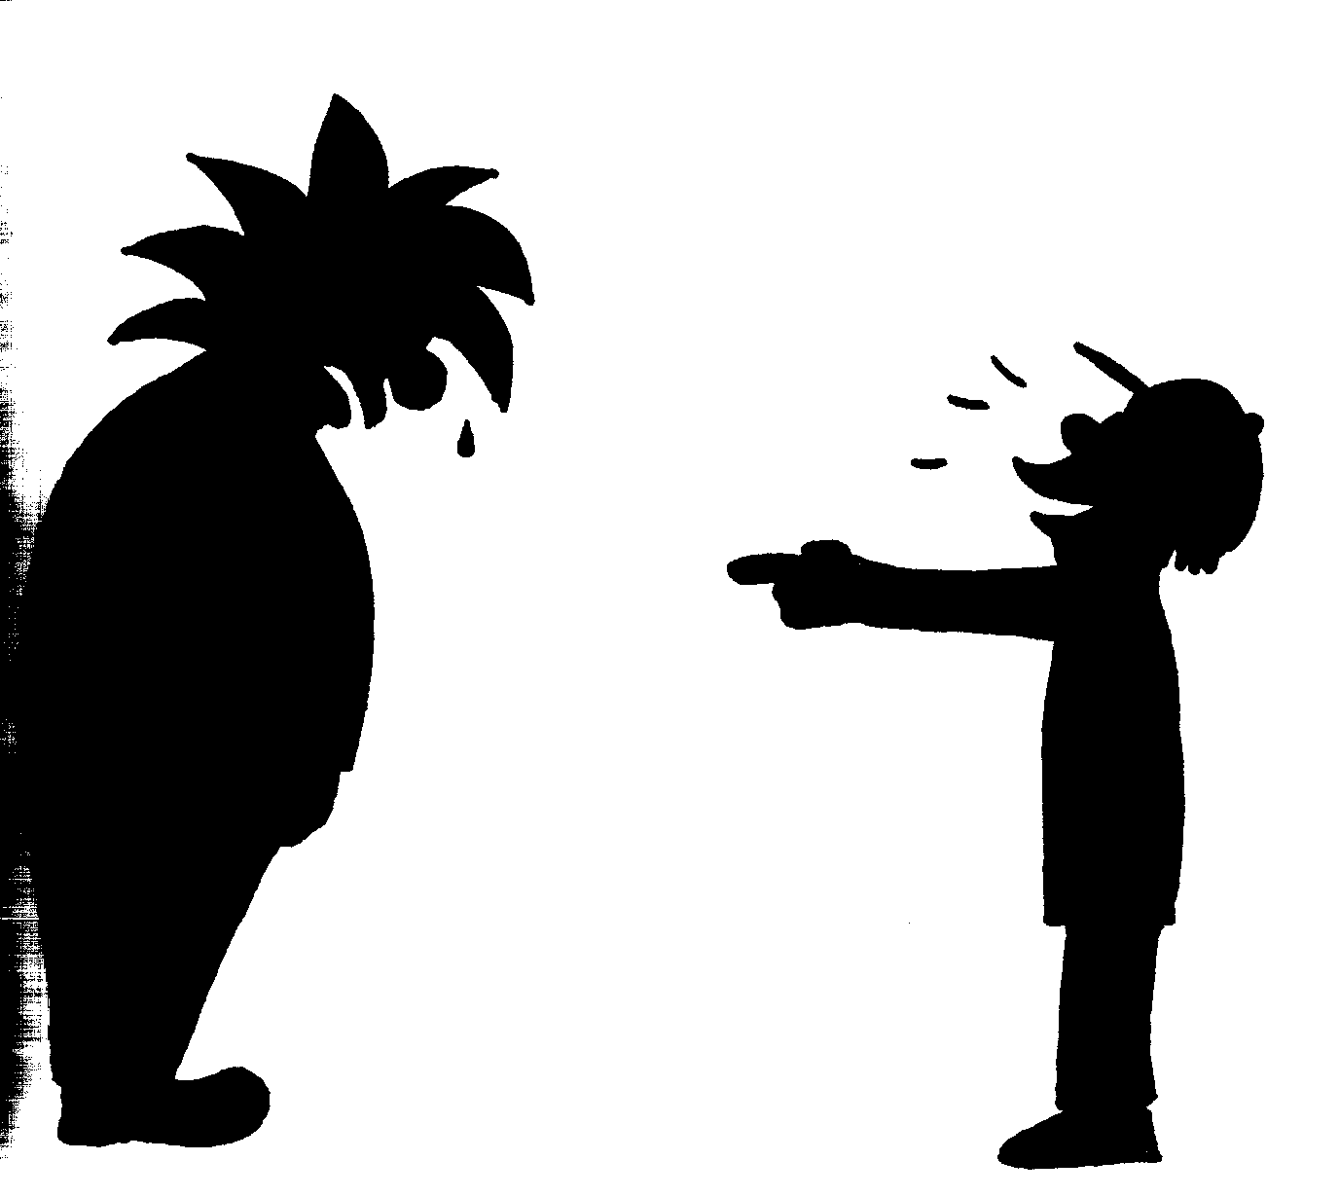
Ender’s Game Vocabulary: Chapters 7 and 8
comparative: relative, how something seems when compared to another
confiscated: taken away with authority
consequences: a result or effect of an action or condition
deliberately: on purpose
efficiency: an action designed to achieve without waste
entangled: to become twisted together or caught up in
grossly: something done in an extreme or excessive way
haphazardly: something done without order or planning
insubstantial: lacking strength or solidity
maneuvers: movement or series of moves requiring skill
methodically: something done in detail and a precise manner
obscurity: being unknown or unimportant
obstacles: something that blocks the way or hinders progress
perception: the state of being aware through the senses
precision: the quality of being exact and accurate
random: chosen without method or conscious decision
rebound: bounce back after hitting a surface or object
ridiculed: making fun of something or someone in a cruel way

Slide 26
Chapter 7 Media Compare and Contrast
Practice w/Launchies: 02:11:14 – 02:13:13 (2min – pg 119 to 120)
In the movie, Bonzo is angry Ender is practicing with Petra. In the book, Petra teaches Ender how to shoot, but Ender is spending his extra practice with his launch group too. Think about how the addition of the launch group practices helps form the relationships between Ender, Alai, and the rest of the launch group.
Discussion: How does offering to teach the launch group the moves he learns from the older soldiers in Salamander make Ender a good commander?
It makes him a good commander because he sees utilizing all his soldiers helps him to improve as well.
He teaches the other launchies new moves, and good commanders show their soldiers how to improve. He and the Launchies try new maneuvers and tactics that the older soldiers wouldn’t dare to try. He introduced the Launchies to maneuvers and tactics they would not get to experience until they had made it into an army.
He shows he is a good commander by teaching the other soldiers how to strategize. He takes his time to learn new things and does not go straight for his enemy unprepared unlike Bonzo.
Prepares the other soldiers for battles, he shares with them the best techniques he knows, guides them into learning new commands – He shares his knowledge gained with his soldiers so everyone is as prepared as possible to face the enemy.

Slide 27
Chapter 7 Media Compare and Contrast
Salamander v. Condor: 02:17:13 – 02:23:14 (6 min – pg 123 to 126)
In the movie, Ender disobeys Bonzo during his first battle. In the book, Ender obeys Bonzo’s order, even though he knows he could have saved their army from being defeated. In the mess hall, when questioned why he did not disobey orders and fire, Ender tells the other solders, “I obey orders.”
How do you think Bonzo and Enders’ actions affected the way the other soldiers view them?
Bonzo:
Other commanders saw that Bonzo was making irrational orders that cost him and his army in the ranks.
They question his ability to command because he is making poor command choices in battles when it comes to his soldiers.
The other commanders might have understood how Bonzo’s command caused the defeat of Salamander.
The other commanders probably questioned Bonzo’s tactics and strategies since he had one active soldier remaining when his army was defeated by Condor.
Ender:
The other commanders see that Ender obeys orders, even if he does not agree with them. This may make it easier for Ender to be transferred to another army.
They will respect him more for following orders.
He will be respected more by the other commanders/soldiers for obeying orders.
The other soldiers respected him more for following orders when they knew those orders could have been disobeyed and saved the army from being defeated.

Slide 28
Chapter 7 Story Map (Book)
Between Condor and Leopard: 02:23:14 – 02:26:15
This portion of the text is only 1.5 pgs (3 min read). However, it summarizes five important events/insights into things that affected Ender while at Battle School. Summarize these 5 events in a story map.
A side effect of Ender sitting out of the battle was he came out on top of the “prized” efficiency list.
His practices with the Launchies gained interest because they were seeing results. Practices in the evening were the best time of day.
Ender turns 7, but no one in Battle School shares birthdays.
Ender continued to obey Bonzo’s ridiculous order for two additional battles.
The only reason Ender is at Battle School is to protect Valentine. He misses his family and wants to go home.
Keep this map separate from our main story map, but keep it with EG documents.

Slide 29
Chapter 7 Story Map (Book)
THINK: Why are these 5 events important to understanding who Ender is and how being at Battle School has changed him?
(T) “I do care. The only reason I’m here is so that a bugger won’t shoot out Valentine’s eye …” (D) Trained with his launch group and learned new strategies because they were not afraid to try new tactics. (OC) Ended up efficiency list because he obeyed Bonzo. He also turned 7. (E) No one shares information about home or birthdays.
(T) Only reason he is at Battle School is to protect Valentine. (D) Uses what he learns from watching Salamander to train his launch group. (OC) Because he obeyed Bonzo, he ended up the leader of the efficiency list. Turned 7. (E) No one talks about home, nothing existed before Battle School.
Sociogram Adj (Ender): Obedient, isolated/lonely
(T) Bonzo has a good army even though he does not have good strategy. (D) Trains with Alai and launchies, learns new maneuvers no “self-respecting” soldier would try. (OC) Takes lead in efficiency list and turns 7. (E) Wants to tell Petra about his birthday, but no one talks about home at Battle School because it is childish.
*Categorize and record the information into your character attribute web:
What Ender Thinks
What Ender Does
Other Conflicts
Environment

Slide 30
Chapter 7 Media Compare and Contrast
Salamander v. Leopard: 02:26:15 – 02:31:35 (5.5 min – pg 128 to 131)
In the movie, Ender disobeyed Bonzo during his first battle. In the book, Ender obeys Bonzo’s order through 3 battles before disobeying him.
How might this change your perspective of Ender’s ability to follow orders and expectations he might have of his own soldiers if he were to command his own army?
We know Ender is serious about being a soldier because he refuses to disobey orders, even when he knows they are not benefiting his army; but we also know he will do what is best for himself as a soldier and a commander – there is only so much he will put up with before he acts in self-interest.
Ender would expect his soldiers to follow orders, but also expect them to bring concerns and advice to him if they see a situation from another perspective.
Ender will trust his soldiers to make decisions if they feel the situation has changed.
It shows he is patient, he will trust his soldiers to modify orders based on their current circumstances – commanders cannot be aware of minute-by-minute decisions being made by his troops.

Slide 31
Chapter 8 Media Compare and Contrast
Graff Stacking the Game: 02:31:35 – 02:34:34 (3 min – pg 132 to 134)
Book: This is an important point where authority interferes in Ender’s ability to make decisions and the events he encounters at Battle School. Record this under the appropriate category in your CAW.
Rat Army: 02:37:55 – 02:41:01 (3 min 6 sec – pg 136 to 138)
BOOK: All of chapter 8 (pg 132-154) surrounds Ender’s time in Rat Army. Ender’s time with Rat Army is not even mentioned in the movie. The movie throws Dink into Salamander Army, but really does not explain the importance of Dink’s character.
How did going back and reading this section help you understand how important Dink is to Ender’s success in Battle School? How would you summarize what Dink does for Ender on your CAW?
Gave him knowledge of how to maneuver more efficiently. Gave him an opportunity to actually practice maneuvers with an army. He learned that a small toon practicing independently gives the army an extra advantage over the enemy because they are not dependent on the commanders orders and can make immediate decisions based on the battle.
He learns new tactics and maneuvers, but puts his own spin on them with the Launchies. Having a specialty toon within the army allows soldiers to learn more tactics and maneuvers than one single commander could offer. Dink encourages Ender to continue practice with the Launchies.
It shows Ender has been accepted as a soldier and is allowed to participate in battles and practices. He teaches and lets him practice battle room maneuvers.
Up until this point, Ender has not had the opportunity to use his full potential. Dink sees the potential in Ender, even if he does not understand WHY Ender is special. Not only does Dink offer Ender the opportunity to improve, but Dink and Rose both give Ender insight to the type of leader he respects. Summary: Dink tells Ender he asked Rose to get him from Salamander, utilizes Ender, and teaches him new maneuvers.

Slide 32
Chapter 8 Media Compare and Contrast
Fight in Null-G: 02:54:47 – 03:06:00 (12 min – pg 147 to 154)
BOOK: This fight in Null-G between the Launchy practice group and the older soldiers is removed from the movie entirely. However, this last part of the text selection contains 3 of the 5 main events summarizing the chapter.
Be sure you have filled in and modified all the current information for our story maps, then identify the three most important parts from this selection of text. You will then summarize the events in the remaining boxes for the story map on the following slide.

Slide 33
Chapter 7 Study Guide Questions
Study Guide Questions:
Where has Ender been transferred? Salamander Army
What does Alai whisper to Ender? “Salaam”
What do the children at the playground game turn into? wolves
Why can’t Ender palm his locker open at Salamander? It’s not locked; nothing is private
Who volunteers to show Ender how to shoot? Petra Arkanian, the only girl in Salamander
Why does Ender think that adults at the school are the enemy? They have not told the truth about controlling gravity.
Why does Ender get the Launchies to practice with him? No one else will practice with him.
Who does Ender tell about his birthday? No one
Why did Ender go to Battle School? So Valentine would be safe from buggers.
What four things has Ender learned about battles from Salamander? He learned that the enemy’s gate is down, to use his legs as a shield, a small reserve used at the end of a game can be important, and sometimes soldiers can make smarter decisions than their leaders.
Where are the things Ender values? In the school computer and in his head and hands
For what course does Ender register? Earth-gravity personal combat

Slide 34
Chapter 8 Study Guide Questions
Study Guide Questions:
Why doesn’t Dink correct his toon members when they say they don’t like Ender’s method of attack? He doesn’t understand how it actually works.
Who watches Ender’s first night practice after he joins the Rats? Petra and Dink
What is the first battle order Rose gives Ender? To lead the troops through the door and go straight toward the enemy’s door.
Who does Dink say is the enemy? The teachers
What scare tactics are used on some of the Launchies who practice with Ender? Some are slapped around, their files are trashed, or they have accidents in the game room or mess hall.
Who starts the fight in the practice room? How does it start? Ender and Alai; they throw a frozen soldier at one of the older boys.
How are the older boys’ injuries listed in the medical report? Accidental Collision in Null G
How many boys show up for Ender’s practice the night after the fight? 45
What is Ender’s worst fear? That he is a killer.

Slide 35
POD TALK/SHARE Chapter 1-8
What are some possible themes of Ender’s Game we have already encountered that have been built upon, and what are some possible new themes? (RL.7.2)
How have the different settings (school/home/Battle School) helped develop the characters and the plotline? How have the various armies (Launch, Salamander, and Rat) helped develop the characters and the plotline? (RL.7.3)

Slide 36
POD TALK/SHARE Chapter 1-8
What are some possible themes of Ender’s Game we have already encountered that have been built upon, and what are some possible new themes? (RL.7.2)
How have the different settings (school/home/Battle School) helped develop the characters and the plotline? How have the various armies (Launch, Salamander, and Rat) helped develop the characters and the plotline? (RL.7.3)
1st:
2nd:
5th:
7th:

Slide 37
Prediction Question Chapter 5-8
3. 5-6: Will Alai become one of Ender’s allies?
4. 7: Would an army be successful under Ender’s command?
5. 8: How were Val and Peter placed in the mind game? Will the IF let Ender keep playing it?
Chapter/Pages | CHARACTERS | CONFLICT | PREDICTION | WHY? | CORRECT?
Chpt 5-6 69-98 | Anderson Dap Alai Shen Bean Bernard | Ender v Launch Group/Older Boys in gameroom (CvS) Ender v Bernard (CvC) | Alai will/will not become one of Ender’s allies. | I predict this because…
Chpt 7 99-131 | Bonzo Petra | Ender v Bonzo (CvC) | An army will/will not be successful under Ender. | I predict this because…
Chpt 8 132-154 | Dink | Ender v Older boys (CvS) Ender v IF Authorities (CvS) | I predict Val and Peter were put in the mind game by …; and that the IF will/will not allow him to keep playing it. | I predict this because…

Slide 38
Character Attribute Web: Chapters 5-6
f
What Ender thinks:
What Ender says:
What Ender does:
The book offers internal dialog to Ender’s thought patterns as he was observing in the game room.
He thinks he is skilled enough to learn the holographic games quickly and defeat the older boys.
“I’m a murderer, even when I play. Peter would be so proud of me.” (pg 98)
Plans ahead using what he has observed and learned from the situation (GR while watching other boys “I could beat them this way. I could beat them that way.” (pg 79)
Goaded the older boys by saying “If you can’t do it twice, you can’t do it at all.” (pg 80)
Caught on quickly by watching older boys. Learned controls and maneuvers by their hand movements.
He studied the game and came up with a strategy before challenging one of the older boys.
Rather than “following the rules” and continuing to die, Ender killed the Giant (viciously).
Environment (School/Home/Battle School):
What others do to Ender:
Ender is still an outcast, but he is strategically building relationships with the other soldiers.
Bernard began creating conflict between Ender and the other launchies.
Lt. Anderson gives Ender access to the mind game so she can analyze his mental/emotional state.
Andrew Wiggin
“Ender”
.
Authority interaction or inaction and how it affects Ender’s decisions:
Other conflicts that affect Ender:
.
.
.
.
.

Slide 39
Character Attribute Web: Chapters 7-8
What Ender does:
f
What Ender thinks:
What Ender says:
Ender thinks Bonzo making stupid decisions and giving irrational commands will affect the respect his army has for him.
Even though Bonzo has a weak grasp of strategy, Salamander was still one of the better armies.
Everyone pretends they do not care about home, but the only reason he is at Battle School is to protect Valentine from the buggers.
Soldiers can sometimes make decisions that are smarter than the orders they’ve been given. (pg 130)
“I’m your tool, and what difference does it make if I hate the part of me that you most need?” (pg 154)
“If you try to control my free play, I’ll have you iced.” (to Bonzo)
“If you ever want to make your enemy crazy, shout that kind of stuff at them. It makes them do dumb things, to be mad.” (pg 148)
Ender offers to use free play to have extra practice with his launch group.
Ender disobeys the direct order from Bonzo to stay out of the battle when he sees Salamander is loosing and Petra is hurt.
Trained with Alai to come up with new tactics and improve as a soldier, while finding a way to enjoy some of his time at Battle School.
What others do to Ender:
Environment (School/Home/Battle School):
Alai tells Ender “salaam” when he is transferred to Salamander Army.
Bonzo forces Ender to sit out of practice and battles, and tries to limit Ender’s free play activities.
Bonzo corners Ender in the sparring room and threatens him.
Andrew Wiggin
“Ender”
Ender is kept from achieving his true potential by not being allowed to participate in his army’s battles and practices under Bonzo’s command.
Authority interaction or inaction and how it affects Ender’s decisions:
Other conflicts that affect Ender:
Dink tells Ender he asked Rose to get him from Salamander, utilizes Ender, and teaches him new maneuvers.
No one shares birthdays at the Battle School, it was childish. No one talked about home.
Some commanders send older soldiers to Ender’s practice groups to deter the bullying
When Ender returns to the mind game, both Valentine and Peter are there this time. Peter appears after Ender defeats a snake and tells him he is a murderer now.
Ender comes out as the leader on the prized efficiency list because he obeys Bonzo’s order to sit out of battle, causing some soldiers to be angry.
Ender turns 7.
Graff has Ender transferred to Salamander Army after he kills the giant just as he is beginning to gain the other Launchies’ respect.
Graff manipulates the battle games to stack the game against Ender, telling Anderson to run every unfair simulation possible to.
Older soldiers gang up on Ender and Launchies in Null-G practice.
Teachers allow incident in Null-G to be reported as “Accidental Collision”, making it obvious they did not intend to punish the soldiers.

Slide 40
STORY MAP: Chpt 5-6
Launch group arrives at the Battle School in the belt.
Dap introduced the Launchies to their storage compartments, routine, and the battle room.
Conflict in class with Bernard on the desks.
Ender plays the mind game “Giant’s Drink”.
Ender kills the giant in the mind game rather than playing by the “rules”.

Slide 41
STORY MAP: Chpt 7
STORY MAP: Chpt 8
Alai shares a sacred religious phrase with Ender, “salaam”, showing his love and respect for him.
Graff manipulates the battle games to stack the game against Ender, telling Anderson to run every unfair simulation possible to.
Ender is transferred/promoted to Salamander Army under Bonzo Madrid, who forces Ender to sit out of practices and battles.
Ender is traded to Rat Army and learns Dink asked Rose deNose to get him for an independent toon within their army.
Petra trains Ender to shoot. Ender begins practicing with launch group, causing conflict with Bonzo.
Launchies are getting bullied and older soldiers fight the group during practice. Reported as “Accidental Collision in Null-G”.
Ender’s practice group begins to see results and gets noticed by other soldiers.
Commanders send older soldiers to Ender’s practices, and the group increases in numbers.
During the battle with Leopard Army, Ender disobeys Bonzo’s orders, and is eventually traded to Rat Army.
Ender knows he is the tool the military needs, but hates the part of him they need the most.

Slide 42
Homework Tonight: Chapter 1-8
Writing Prompt 3 (Chpt 8) – W.7.3a:
W.7.3.A. I can gain the reader's attention by introducing ideas, a point of view, a narrator and/or character.
Instructions: Consider the writing standard above. Write a short narrative answering the following prompt by introducing yourself as the character using the first-person point of view.
In the introduction, Card writes, “…never in my entire childhood did I feel like a child. I felt like a person all along – the same person that I am today”. Does his statement echo your own thoughts? Why or why not?
(*DUE WEDNESDAY– @least 5-8 sentences and 1 page double-spaced*)
Be sure all GOs, ?s, and activities are current and completed for chapters 1-8

Slide 43
Standards: | I Can:
RL.7.2 Determine a theme or central idea of a text and analyze its development over the course of the text; provide an objective summary of the text. | RL.7.2 - I can use details from the text to determine the theme or message of a story. RL.7.2 - I can give an unbiased summary of a story.
RL.7.3 Analyze how particular elements of a story or drama interact (e.g., how setting shapes the characters or plot). | RL.7.3 - I can explain how the elements of a story work together
RL.7.7 Compare and contrast a written story, drama, or poem to its audio, filmed, staged, or multimedia version, analyzing the effects of techniques unique to each medium (e.g., lighting, sound, color, or camera focus and angles in a film). | RL.7.7 - I can compare and contrast the written version of a story, drama or poem to its multimedia or stage production.

